Slide 1

Introduction to R
Academic Skills, Trent University 2020

Slide 2
What is R? What is RStudio?
R is a free, open source software that you can use to manipulate, calculate, and analyze data.
RStudio is a free, open source software that interacts with R and makes it easier to use.

Slide 3
Step 1 – Download and install R
Download R before RStudio.
Go to the R homepage => Click on CRAN mirrors
Choose the appropriate version of R for your computer’s operating system:
Windows
(Mac) OS X

Slide 4
Step 2 – Download and install RStudio
Remember, R is a programming language that tells your computer what to do. RStudio is a convenient interface to write commands in the R language. So you need to download Rstudio after you download R.
Go to the RStudio homepage => Download the free, open source version of RStudio Desktop

Slide 5
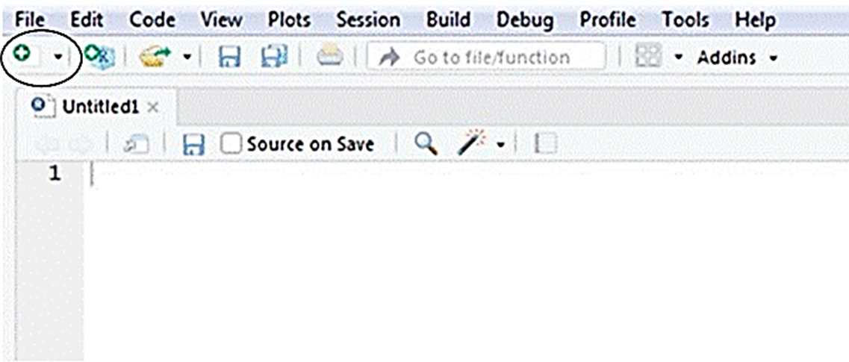
Using RStudio
To get started, open RStudio like you would any other software.
You should see three windows.
Open a fourth window by clicking File => New File => RScript.
Alternatively, you can click the green and white plus sign/blank document icon => RScript.

Slide 6
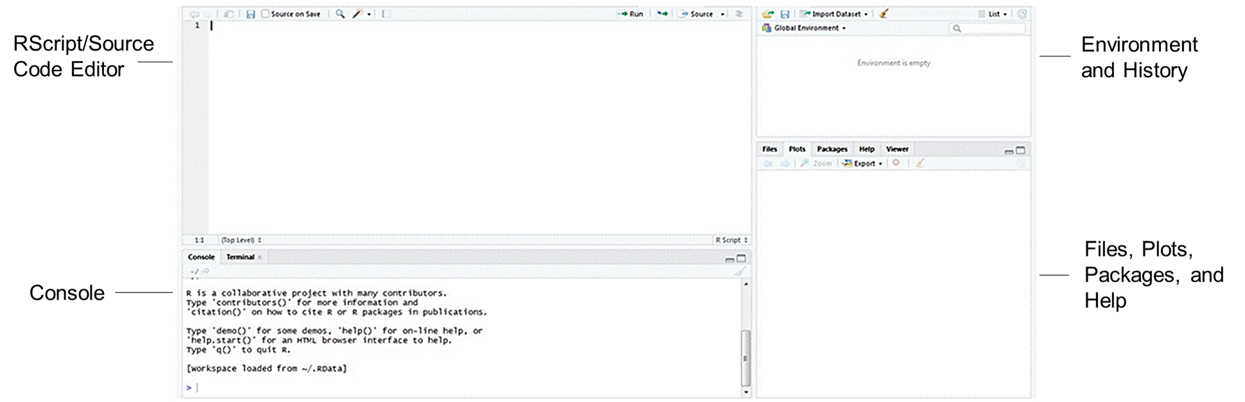
The four windows in RStudio

Slide 7
Description of the RStudio windows
RScript/Source Code Editor – the top left window – is a text editor where you can save your code.
Console – the bottom left window – sends the code to R to execute your commands.
Environment and History – the top right window – view a list of the objects available in your current R session (e.g. data sets, variables, matrices, etc.)
Files, Plots, Packages, and Help – the bottom right window – manage files, view plots, install packages, and access the help menu.

Slide 8
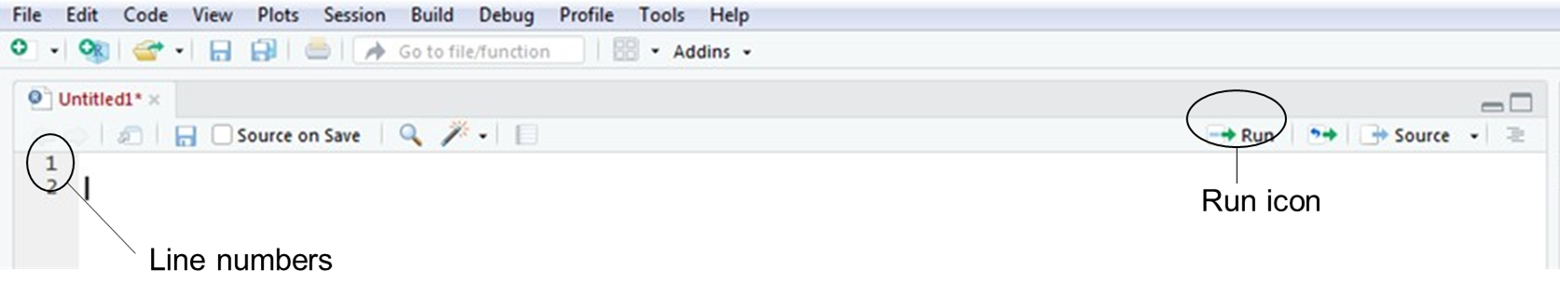
Using RScript
The lines of code in the RScript are numbered to help you stay organized and find errors more easily. Write your code and put your cursor on the line of code you want to run. Send it to the console which runs it in R by clicking on the “Run” icon or by typing “Ctrl + Enter”. Note if you want to run multiple lines of code at the same time, highlight them all and then send them to the console.
Code can be saved in the RScript as a .R file to be rerun or modified at another point in time.

Slide 9
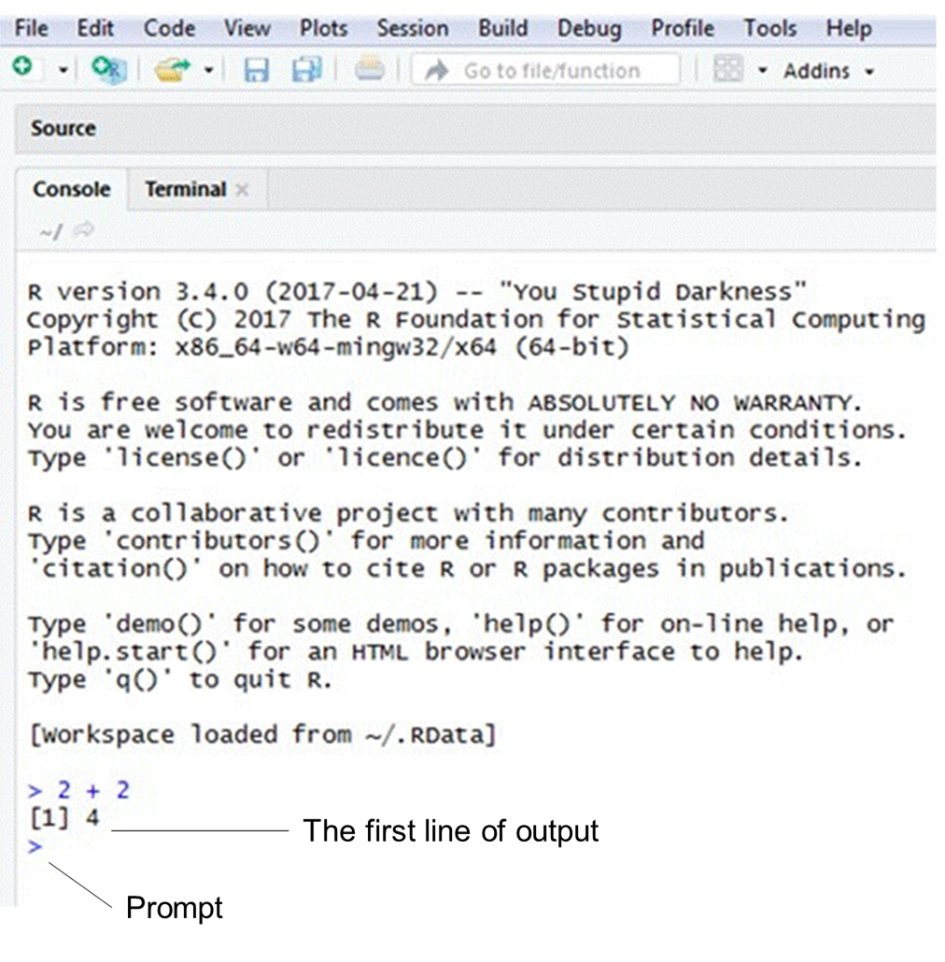
Using the console
If you click in the console, you should see a blinking cursor line (“|”) next to a greater than sign (“>”). This is called a prompt. You can write code next to the prompt and then press the “Enter” key to send the code to R.
The console displays any mistakes in your code (i.e. this is where you will receive error messages). In addition, the console shows your output (i.e. the results of your code) beside square brackets.

Slide 10
What is an R package?
An R package is essentially a bundle of code and data that improves on R’s base capabilities or adds new abilities for R to manipulate, calculate, and analyze data.
When you install R for the first time, base packages are automatically installed.
If you would like to download a new package, use a Google search to determine the most appropriate one for your purpose and then install it.

Slide 11
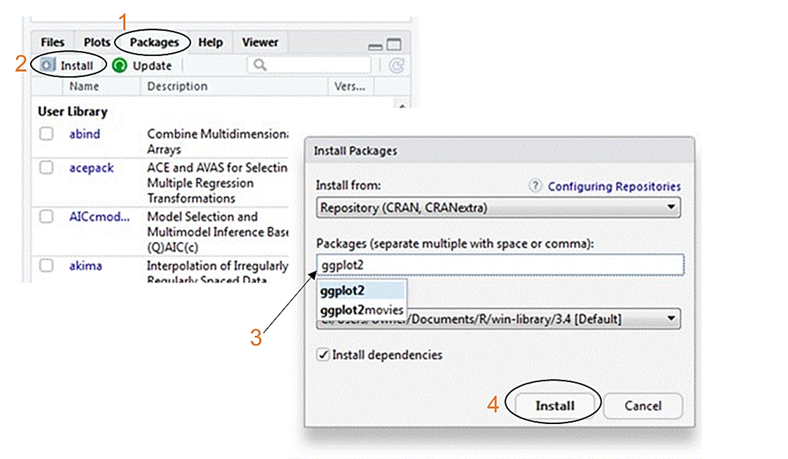
Install packages
There are two ways to install packages:
Go to the “Packages” tab => Install =>Type in the name of the package and click “Install”. Then wait for the package to download.
Use the following code: install.packages(“name of package”)
Example: install.packages(“ggplot2”)

Slide 12
Load packages
Packages only need to be installed once but they will need to be loaded every time you open a new R session and want to use them.
Use the following code to install a package: library(“package name”)
Example: library(“ggplot2”)

Slide 13
Load data
Every time you start a new R session you will need to load the data you want to work with.
There are numerous ways to start working with data in R. Three common ways are to use the built-in data, manually input data, or load a spreadsheet.

Slide 14
Built-in data sets
Use the following code to generate a list of data sets that came with the base package in R:
data()
If you run the name of any of these data sets, you can see the data contained within it.

Slide 15
Manually type in data
Create an object, assign values to it, click “Run”.
It is a good practice to annotate your code (i.e. provide a description) to remind yourself what you are trying to accomplish with your code. Use a number sign/hashtag (“#”) in front of your comments so that R does not read this as code.
Introduction to example (next slide):
This screenshot shows an example of code that creates an object and assigns values to it.
The code starts by naming an object "example".
To the right of this name is the less than symbol followed by a hyphen. This symbol means assign values to the object "example".
The next piece of code is a "c" which is the concatenate function and groups individual data points together. Then there is the data in an open parenthesis followed by a closed parenthesis.

Slide 16
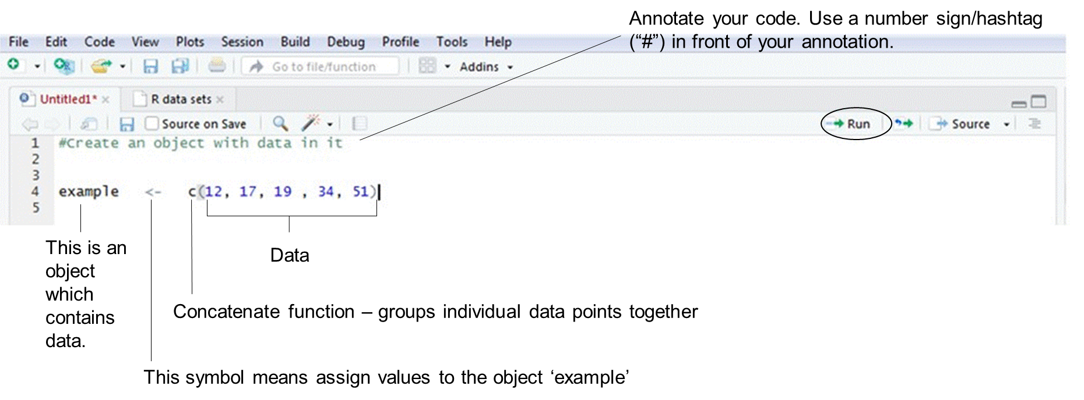
Example of manually typed data

Slide 17
Errors
R will not execute a command if it is written incorrectly. If you have a mistake in your code, an error message will show up in the console.
Some of the most common errors occur due to the following:
Inconsistent capitalization and spelling or incorrect punctuation
Parentheses or brackets that have not been closed

Slide 18
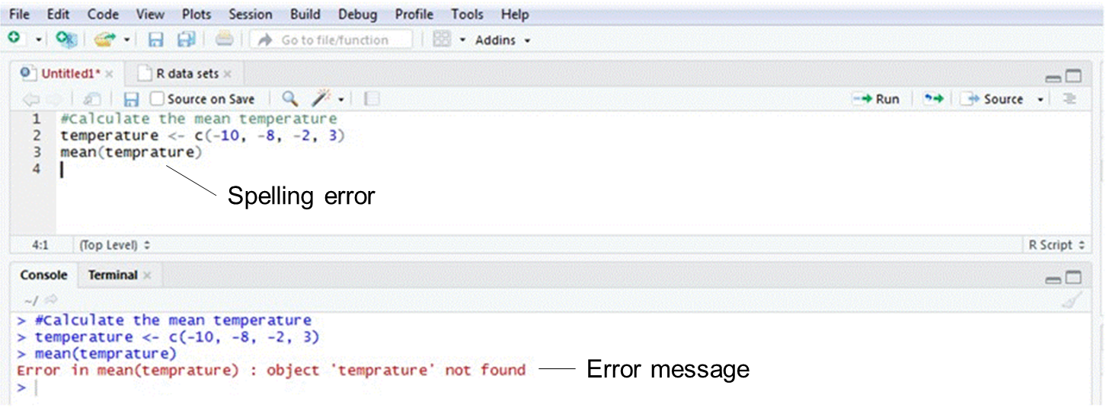
Capitalization, spelling, and punctuation
Use the same capitalization and spelling throughout your code.
Ensure you punctuation is correct. Commas separate components of the code so it is important to make sure they are in the right spot.

Slide 19
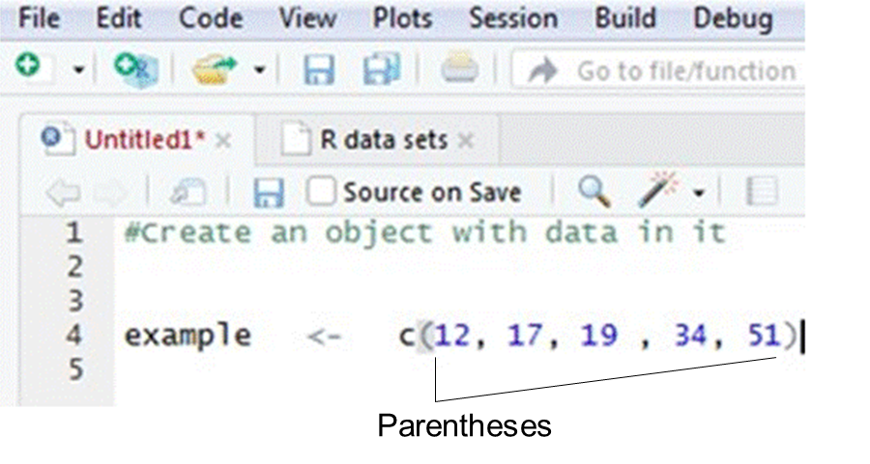
Brackets and parentheses
Make sure all your parentheses and brackets open and close (i.e. they should face forward and backward).
Example
( ) or [ ] or { }
Note: Parentheses, square brackets, and curly brackets mean different things and are not interchangeable. Most of the time you will use parentheses ( ).
In the RScript, corresponding parentheses and brackets will be highlighted in grey.

Slide 20
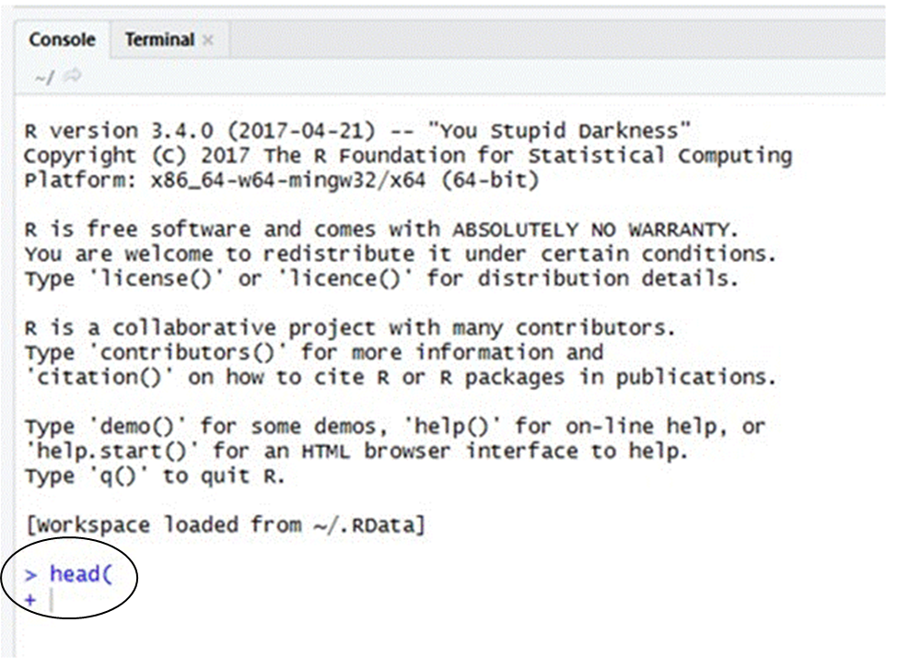
A plus sign (“+”) in the console
If the console displays a plus sign (“+”) it means something is missing (e.g. usually you have forgotten to close your parentheses) and R is waiting for you to add it.
Press the escape key (“Esc”) and then “Enter” to get back to the prompt (“>”).

Slide 21
Getting help
Use the following code to access the help menu:
help(“package or function name”)
Example
help(“ggplot2”)

Slide 22
Data Types in R
R Programming has 5 data types:
Character
Numerical
Integer
Logical
Complex.
Character Data Type: Character data type stores letter or a combination of letters enclosed within the quotes. Eg: ‘a’, “good”, ’65’, etc.
Numerical Data Type: Numeric data types stores digits and decimal numbers. Eg: 23.2, 44, etc.
Integer Data Type: Integer data type stores integer number, numbers that do not contain decimal values. They are mentioned with the letter ‘L’ towards the end so that the programming language stores it as an integer. Eg: 2L, 67L, etc.
Logical Data Type: Logical data type stores boolean values True or False.
Complex Data Type: Complex data type stores complex numbers, a combination of real and imaginary numerical values. Eg: 4+7i.

Slide 23
Data Structures/Data Objects/Data Types
R programming supports 6 types of data objects.
Vector
List
Data Frame
Matrix
Array
Factor
In programming languages like C, C++ and Java, variables are declared as data type; however, in R the variables are not
declared as some data type. Variable are treated like a data objects. They are particular instance of particular class.
Objects are nothing but a data structure having few attributes and methods which are applied to its attributes. (Just like in Python). For eg: Matrix class includes set of attributes and set of methods to be applied on these attributes like dim( ), length( ), attributes( )

Slide 24
Data Structures/Data Objects/Data Types
Vectors
Vectors are one of the basic R programming data objects containing sequence of data elements of the same data type.
Members in a vector are officially called components.
Vectors are generally created using the c( ) function.
Creating Vector
V1<-c(10,20,30)
V2<-c('a','b','c')
Printing vector
V1
V2

Slide 25
Data Structures/Data Objects/Data Types
Vectors
V1<-c(10,20,30) #Creating Vector
V1 #Pinting Vector
V2<-c('a','b','c') V2
V3<-c(10.5,20.5,30.5) V3
V4<-c("Raju","Sanju","Manju") V4
V5=c(50,60,70,0)
V5
print(V1) V1*2 V1+2 V1/2 V1/3 V1=V1*2 V1 V1%%2
class(V1) class(V2) class(V3) class(V4)

Slide 26
Data Structures/Data Objects/Data Types
Vectors
xm <- mean(V1)
xm str(V1)
V6<-c(1:200) V6
V61 <- c(0:10, 50)
V61
str(V61)
V7<-seq(1, 3, by=0.2) V7
V71<-seq(1, 20, by=2) V71
V8<-LETTERS[1:5]
V8 V1 V1[3]
V1[c(1, 3)] V1[2:3]
V1[-1]
V1[-2] V1[6]
V1[2] <- 0; # modify 2nd element V1

Slide 27
Data Structures/Data Objects/Data Types
Vectors
V8=c(10,-2,20,-4) V8
V8[V8<0] <- 5 V8
length(V1) V1=c(V1,40,50,60) V1
#The function c() can also be used to add elements to a vector.
V9 <- c(0.5, NA, 0.7) # R supports missing data in vectors. They are represented as NA (Not Available) and can be used for all the vector types
V9
anyNA(V9) #anyNA() returns TRUE if the vector contains any missing values # The function is.na() indicates the elements of the vectors that represent missing data.
V10=c(1,'a')
V10
dim(V1) #returns NULL because an atomic vector doesn’t have a dimension. V11 <- cbind(1, 2, 3, 4, 5) #We can create a true vector with cbind() class(V11)
dim(V11) #This returns the dimension (number of LInes first, the number of Columns).

Slide 28
Data Structures/Data Objects/Data Types
Lists
Lists are one of the basic R programming data objects containing data elements of different data types like number,
character, strings. It can also contain vectors, matrices, a nested list itself inside it as elements.
List can be created using the list() function.
L1=list(10,'a',20.5,"Raju")
#Creating List
L1 #Printing List
L2=list(11,'b',30.5,"Sanju",L1)
L2
typeof(L1)
length(L1)
L1[c(1:2)] # index using integer vector Indexing with [ ] will give us sublist not the content inside the component.
L1[-2]
# using negative integer to exclude second component

Slide 29
Lists
L3 <- list("a" = 2.5, "b" = TRUE, "c" = 1:3) # can give tag names, However, tags are optional.
L3
L4 <- list("Name" = "John", "Age" = 20, "Branch" = "CS") L4
L4["Age"]
L4$Age
# However, this approach will allow us to access only a single component at a time.
# an alternative approach.
L4[["Name"]] <- "Clair" # We can change components of a list through reassignment
L4
L4[["Married"]] <- FALSE L4
# Adding new components is easy. We simply assign values using new tags and it will pop into action.
L4[["Age"]] <- NULL
str(L4) L1[1]
# We can delete a component by assigning NULL to it.

Slide 30
Lists
L2 L2[1]
L2[5] L2[[5]][2]
L5=list()
# creating empty list
L5=c(10,'a') #adding elements to the list
names(L4) L5
L6 <- list(c(1, 2), c(3, 4))
L6
L7 <- list(3, c(1, 2), "lists are amazing!") L7
L1
L8=list(L1,50,'b',"Red") L8

Slide 31
Data Structures/Data Objects/Data Types
Lists
Lists can be extremely useful inside functions. Because the functions in R are able to return only a single object, we can
“staple” together lots of different kinds of results into a single object that a function can return.
A list does not print to the console like a vector. Instead, each element of the list starts on a new line.
Elements are indexed by double brackets. If the elements of a list are named, they can be referenced by the $ notation (i.e. xlist$data).

Slide 32
Data Structures/Data Objects/Data Types
Matrix
Matrix is a two dimensional data structure in R programming.
Same as vector, the components in a matrix must be of the same basic type.
Matrix can be created using the matrix() function.
Dimension of the matrix can be defined by passing appropriate value for arguments nrow and ncol.
M1<-matrix(data=7,nrow=3,ncol=3) M1
M2<-matrix(data=(1:9),nrow=3,ncol=3,byrow=F) M2
We can see that the matrix is filled column-wise. This can be reversed to row-wise filling by passing TRUE to the argument byrow.
M3<-matrix(data=(1:9),nrow=3,ncol=3,byrow=T) M3
byrow=TRUE signifies that the matrix should be filled by rows. byrow=FALSE indicates that the matrix should be filled by columns (the default).

Slide 33
Data Structures/Data Objects/Data Types
matrix1<- matrix(0, nrow = 5, ncol = 5)
print(matrix1)
[,1] [,2] [,3] [,4] [,5]
dim(matrix1)
[1] 5 5
length(matrix1) [1] 25
attributes(matrix1)
$dim [1] 5 5
$dimnames
$dimnames[[1]]
[1] "R1" "R2" "R3" "R4" "R5"
$dimnames[[2]]
[1] "C1" "C2" "C3" "C4" "C5"
[1,] | 0 | 0 | 0 | 0 | 0
[2,] | 0 | 0 | 0 | 0 | 0
[3,] | 0 | 0 | 0 | 0 | 0
[4,] | 0 | 0 | 0 | 0 | 0
[5,] | 0 | 0 | 0 | 0 | 0
rownames(matrix1)<-c("R1","R2","R3","R4","R5")
colnames(matrix1)<-c("C1","C2","C3","C4","C5")
print(matrix1)
C1 C2 C3 C4 C5
R1 | 0 | 0 | 0 | 0 | 0
R2 | 0 | 0 | 0 | 0 | 0
R3 | 0 | 0 | 0 | 0 | 0
R4 | 0 | 0 | 0 | 0 | 0
R5 | 0 | 0 | 0 | 0 | 0

Slide 34
Data Structures/Data Objects/Data Types
Matrix
In all cases, however, a matrix is stored in column-major order internally.
Providing value for both dimension is not necessary. If one of the dimension is provided, the other is inferred from length of the data.
M4<-matrix(data=(1:9),nrow=3) M4
It is possible to name the rows and columns of matrix during creation by passing a 2 element list to the argument dimnames.
M5 <- matrix(1:9, nrow = 3, ncol=3,byrow=F,dimnames = list(c("R1","R2","R3"), c("C1","C2","C3")))
M5
These row names and column names can be accessed or changed with two helpful functions colnames() and rownames().
rownames(M5)
colnames(M5)

Slide 35
Data Structures/Data Objects/Data Types
Matrix
It is also possible to change row names and column names
rownames(M5) <- c("ROW1","ROW2","ROW3")
colnames(M5) <- c("COL1","COL2","COL3")
M5
rownames(M5) colnames(M5) attributes(M1) dim(M1)
Another way of creating a matrix is by using functions cbind() and rbind() M6<-cbind(c(1,2,3),c(4,5,6))
M6
M7<-rbind(c(1,2,3),c(4,5,6)) M7

Slide 36
Data Structures/Data Objects/Data Types
Matrix
Finally, we can also create a matrix from a vector by setting its dimension using dim(). Matrices can also be created
directly from vectors by adding a dimension attribute.
M8 <- c(1,2,3,4,5,6)
M8
class(M8)
dim(M8) <- c(2,3)
M8
class(M8)
We can access elements of a matrix using the square bracket
M8[2,3]
M8[c(1,2),c(2,3)]
M8[c(1,2),c(1,3)]
M8[c(2),c(2,3)]

Slide 37
Data Structures/Data Objects/Data Types
Matrix
select elements greater than 5
M8
M8[M8>4] M2
M2[2,] #2nd row of a matrix
M2[,3] #3rd column of a matrix
select even elements
M8[M8%%2 == 0]
We can combine assignment operator with the above learned methods for accessing elements of a matrix to modify it.
M8[2,2] <- 10;
M8
modify elements less than 5.
M8[M8<5] <- 0
M8
A common operation with matrix is to transpose it. This can be done with the function t().
t(M8)

Slide 38
Data Structures/Data Objects/Data Types
Matrix
We can add row or column using rbind() and cbind() function respectively. Similarly, it can be removed through reassignment.
M9<-rbind(c(10, 20, 30),c(40, 50,60),c(70,80,90))
M9
M9<-cbind(M9, c(1, 2, 3)) M9
M9<-rbind(M9,c(1,2,3,4)) M9
In all cases, however, a matrix is stored in column-major order internally
M10<-rbind(c(10, 20, 30),c(40, 50,60))
M10
[,1] [,2] [,3]
[1,] 10 20 30
[2,] 40 50 60
Dimension of matrix can be modified as well, using the dim() function.
dim(M10) <- c(3,2);
M10
[,1] [,2]
[1,] | 10 | 50
[2,] | 40 | 30
[3,] | 20 | 60

Slide 39
Matrix
We can perform mathematical operations on matrices
M1
M2 M1+M2 M1-M2 M1*M2 M1%*%M2 M1/M2 M1%%M2

Slide 40
Data Frames
Data Frame is a type of data object in R. It is two dimensional object where each column is of one data type i.e, different column in the frame is of different data type.
It is a special case of a list.
DataFrame can be created using the data.frame() function.
num1<- c(1,2,3,4)
char1<-c('a','b','c','d')
real1<-c(10.5,20.5,30.5,40.5)
str1 <- c("Red", "White", "Green","Black") logical1<- c(TRUE,TRUE,TRUE,FALSE)
F1<-data.frame(num1,char1,real1,str1,logical1)
F1
Output
num1 | char1 | real1 | str1 | logical1
1 | a | 10.5 | Red | TRUE
2 | b | 20.5 | White | TRUE
3 | c | 30.5 | Green | TRUE
4 | d | 40.5 | Black | FALSE

Slide 41
Frames
Following are the characteristics of a data frame.
The column names should be non-empty.
The row names should be unique.
The data stored in a data frame can be of numeric, factor or character type.
Each column should contain same number of data items.
We can print the data frame using print()
print(F1)
Get the structure of the data frame.
str(F1)
We can print the names of the data frame using names()
names(F1)
We can print attributes of the data frame using attributes()
attributes(F1)
Output
$names
[1] "num1"
$class
"char1"
"real1"
"str1"
"logical1"
[1] "data.frame"
$row.names [1] 1 2 3 4

Slide 42
Data Structures/Data Objects/Data Types
Frames
We can print class of the data frame using class() function
class(F1)
We can access the class of each column in the data frame using sapply() function
sapply(F1, class)
We can access number of rows and number of columns in the data frame using nrow() and ncol() function. nrow(F1)
ncol(F1)
Data frames can be accessed like a matrix by providing index for row and column.
F1
F1[2,3]
F1[2,]
F1[,3]
F1[2:4]
We can access specific column with in the data frame
F1["str1"]
F1$str1

Slide 43
Data Structures/Data Objects/Data Types
Frames
We can modifying the content of a Data Frame in R
F1[2,3]<-100.5
F1
F1[2,"str1"]<-"Yellow" F1
We can give row names to the data frame using rownames() or row.names()
F1
names<-c("A","B","C","D")
rownames(F1)<-names
F1
We can give column names to the data frame using names().
F1
names(F1)<-c("E","F","G","H","I")
F1

Slide 44
Data Structures/Data Objects/Data Types
Frames
Data Frame has been widely used in the reading comma-separated files (CSV), text files. Their use is not only limited to reading the data, but you can also use them for machine learning problems, especially when dealing with numerical data. Data Frames can be useful for understanding the data, data wrangling, plotting and visualizing.
A data frame is a very important data type in R. It’s pretty much the de facto data structure for most tabular data and what
we use for statistics.
Note that for data frames, there is a separate function for setting the row names, the row.names() function. Also, data frames do not have column names, they just have names (like lists). So to set the column names of a data frame just use the names() function.
Object | Set column names | Set row names
data frame | names() | row.names()
matrix | colnames() | rownames()

Slide 45
Data Structures/Data Objects/Data Types
Matrix vs Data frame in R
A data structure is a particular way of organizing data in a computer so that it can be used effectively. The idea is to reduce the
space and time complexities of different tasks.
The two most important data structures in R are Matrix and Data frame, they look the same but different in nature.
Matrix in R
It’s a homogeneous collection of data sets which is arranged in a two dimensional rectangular organisation. It’s a m*n array with similar data type. It is created using a vector input. It has a fixed number of rows and columns. We can perform many arithmetic operations on R matrix like – addition, subtraction, multiplication, and divisions.
DataFrames in R
It is used for storing data tables. It can contain multiple data types in multiple columns called fields. It is a list of vector of equal length. It is a generalized form of a matrix. It is like a table in excel sheets. It has column and row names. The name of rows are unique with no empty columns. The data stored must be numeric, character or factor type. Data Frames are heterogeneous.

Slide 46
Factors
Factor is a type of data object in R that takes only predefined, finite number of values (categorical data).
For example, a data field such as marital status may contain only values from the set { Single, Married, Separated, Divorced, , Widowed } . Performance field may contain the values from the set { Excellent", "Good", "Average", "Poor }
These predefined, distinct values are called Levels. They can be strings or integers.
They are extremely useful in data analytics for statistical modelling.
A Factor can be created using the function factor(). Levels of a factor are inferred from the data if not provided.
FT1 <- factor(c("Single", "Married", "Married", "Single")); FT1
FT2 <- factor(c("Single", "Married", "Married", "Single", "Divorced"),levels = c("Single", "Married", "Divorced")); FT2

Slide 47
Data Structures/Data Objects/Data Types
Factors
Factors are closely related with vectors. In fact, factors are stored as integer vectors. This is clearly seen from its structure.
We can access structure of a factor using str() function
str(FT2) Output
Factor w/ 3 levels "Single","Married",..: 1 2 2 1 3
FT2 <- factor(c("Single", "Married", "Married", "Single", "Divorced"),levels = c("Married", "Single","Divorced"));
FT2
str(FT2) Output
Factor w/ 3 levels "Married","Single",..: 2 1 1 2 3
Number of level defined in the factor can be accessed using nlevel() function
nlevels(FT2)

Slide 48
Factors
For Eg: A variable gender with 20 "male" entries and 30 "female" entries
gender <- c(rep("male",20), rep("female", 30)) #rep() is a replicate function creates a vector with 20 Male entries and 30 Female entries
gender
gender <- factor(gender, order = TRUE,levels = c("male","female")) gender
str(gender)
gender[1]>gender[21] gender[21]>gender[1]
gender <- c(rep("male",20), rep("female", 30))
gender
gender <- factor(gender, order = FALSE,levels = c("male","female")) gender
str(gender) gender[1]>gender[21] gender[21]>gender[1]

Slide 49
Exporting data is writing data from R to .txt (tab-separated values) and .csv (comma-separated values) file formats.
It’s also possible to write csv files using the functions write.csv() and write.csv2().
write.csv() uses “.” for the decimal point and a comma (“,”) for the separator.
my_data<-c(10.5,20.5,30.5,40.5)
getwd()
write.csv(my_data, file = "my_data.csv")
write.csv2() uses a comma (“,”) for the decimal point and a semicolon (“;”) for the separator.
write.csv2(my_data, file = "my_data1.csv")
The R base function write.table() can be used to export a data frame or a matrix to a file.
x<-matrix(data=c(10.5,20.5,30.5,40.5,50.5,60.5,70.5,80.5,90.5),nrow=3,ncol=3)
write.table(x, "my_data2", append = FALSE, sep =" ", dec = ";",row.names=TRUE, col.names=TRUE) write.table(x, "my_data2", append = FALSE, sep =" ", dec = ".",row.names=TRUE, col.names=TRUE) write.table(x, "my_data2", append = TRUE, sep =" ", dec = ".",row.names=TRUE, col.names=TRUE) write.table(x, "my_data2", append = FALSE, sep =" ", dec = ".",row.names=TRUE, col.names=TRUE)

Slide 50

The R base function write.table() can be used to export a data frame or a matrix to a file.
x<-matrix(data=c(10.5,20.5,30.5,40.5,50.5,60.5,70.5,80.5,90.5),nrow=3,ncol=3)
write.table(x, "my_data2", append = FALSE, sep =" ", dec = ";",row.names=TRUE, col.names=TRUE) write.table(x, "my_data2", append = FALSE, sep =" ", dec = ".",row.names=TRUE, col.names=TRUE) write.table(x, "my_data2", append = TRUE, sep =" ", dec = ".",row.names=TRUE, col.names=TRUE) write.table(x, "my_data2", append = FALSE, sep =" ", dec = ".",row.names=TRUE, col.names=TRUE)
Syntax:
write.table(x, file, append = FALSE, sep = " ", dec = ".", row.names = TRUE, col.names = TRUE)
x: a matrix or a data frame to be written.
file: a character specifying the name of the result file.
sep: the field separator string, e.g., sep = “\t” (for tab-separated value).
dec: the string to be used as decimal separator. Default is “.”
row.names: either a logical value indicating whether the row names of x are to be written along with x, or a character vector of row names to be written.
col.names: either a logical value indicating whether the column names of x are to be written along with x, or a character vector of column names to be written. If col.names = NA and row.names = TRUE a blank column name is added, which is the convention
used for CSV files to be read by spreadsheets.

Slide 51
Importing and Exporting Data in R
R base functions for importing data from .txt (tab-separated values) and .csv (comma-separated values) file formats
read.csv(): for reading “comma separated value” files (“.csv”).
read.csv2(): variant used in countries that use a comma “,” as decimal point and a semicolon “;” as field separators. read.delim(): for reading “tab-separated value” files (“.txt”). By default, point (“.”) is used as decimal points.
read.delim2(): for reading “tab-separated value” files (“.txt”). By default, comma (“,”) is used as decimal points.
read.table() is a general function that can be used to read a file in table format
The R base function read.table() is a general function that can be used to read a file in table format. The data will be imported as a data frame.
# Read tabular data into R
read.table(file, header = FALSE, sep = "", dec = ".")
# Read "comma separated value" files (".csv")
read.csv(file, header = TRUE, sep = ",", dec = ".", ...)
# Or use read.csv2: variant used in countries that # use a comma as decimal point and a semicolon as field separator.
read.csv2(file, header = TRUE, sep = ";", dec = ",", ...)
# Read TAB delimited files read.delim(file, header = TRUE, sep = "\t", dec = ".", ...) read.delim2(file, header = TRUE, sep = "\t", dec = ",", ...)

Slide 52
my_data<-c(10.5,20.5,30.5,40.5)
getwd()
write.csv(my_data, file = "my_data.csv")
write.csv2(my_data, file = "my_data1.csv")
x<-matrix(data=c(10.5,20.5,30.5,40.5,50.5,60.5,70.5,80.5,90.5),nrow=3,ncol=3)
write.table(x, "my_data2", append = FALSE, sep =" ", dec = ";",row.names=TRUE, col.names=TRUE)
write.table(x, "my_data2", append = FALSE, sep =" ", dec = ".",row.names=TRUE, col.names=TRUE)
write.table(x, "my_data2", append = TRUE, sep =" ", dec = ".",row.names=TRUE, col.names=TRUE)
write.table(x, "my_data2", append = FALSE, sep =" ", dec = ".",row.names=TRUE, col.names=TRUE)
a<-read.table("my_data2")
a
b<-read.csv("my_data.csv", header=TRUE, sep =",", dec=".")
b
c<-read.csv2("my_data1.csv", header=TRUE, sep=";", dec=",")
c
read.delim("my_data2")
read.delim("my_data2", header=TRUE, sep="\t", dec=".")
read.delim2("my_data2")
write.table(x, "my_data2", append = FALSE, sep =" ", dec = ";",row.names=TRUE, col.names=TRUE)
read.delim2("my_data2", header=TRUE, sep="\t", dec=";")

